Slide 1
Unit 2: Android
Sunil Gautam

Slide 2
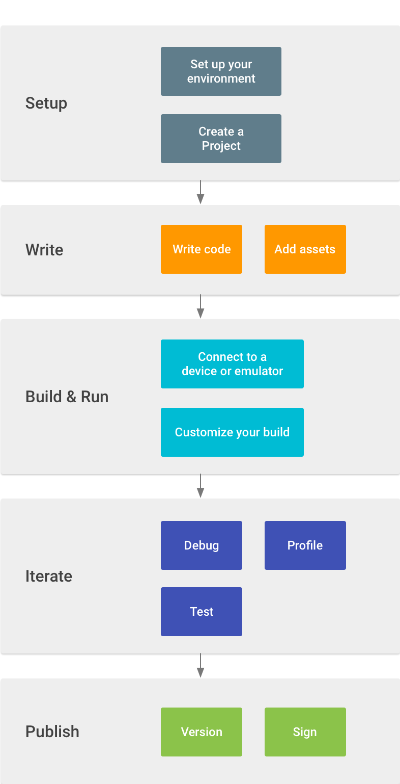
Android

Slide 3
Android Security Feature
The Android operating system is a multi-user Linux system in which each app is a different user.
The system assigns each app a unique Linux user ID (the ID is used only by the system and is unknown to the app).
Each process has its own virtual machine (VM), so an app's code runs in isolation from other apps.
Every app runs in its own Linux process.

Slide 4
Principle of least privilege
Each app, by default, has access only to the components that it requires to do its work and no more.
Data or Resource Sharing can be carried out through :
Sharing of Linux User ID, among processes.
An app can request permission to access device data such as the device's location, camera, and Bluetooth connection. The user has to explicitly grant these permissions.

Slide 5
App Components
App components are the essential building blocks of an Android app.
Each component is an entry point through which the system or a user can enter your app.
Some components depend on others.

Slide 6
App Components
Activities
Services
Broadcast Receivers
Content Providers
Each type serves a distinct purpose and has a distinct lifecycle that defines how the component is created and destroyed.

Slide 7
Activities
Activity is the entry point for interacting with the user.
It represents a single screen with a user interface.
An android application is collection of many such activities
For example,
an email app might have one activity that shows a list of new emails, , another activity to compose an email, and another activity for reading emails.

Slide 8
Activities
Activities allows key interaction among system and app :
Keeping track of what the user currently cares about (what is on screen) to ensure that the system keeps running the process that is hosting the activity.
Knowing that previously used processes contain things the user may return to (stopped activities), and thus more highly prioritize keeping those processes around.
Helping the app handle having its process killed so the user can return to activities with their previous state restored.
Providing a way for apps to implement user flows between each other, and for the system to coordinate these flows.

Slide 9
Activities
An Activity represents the visual representation of an Android application.
Typically correspond to one UI screen
But, they can:
Be faceless
Be in a floating window
Return a value
Most applications have multiple activities

Slide 10
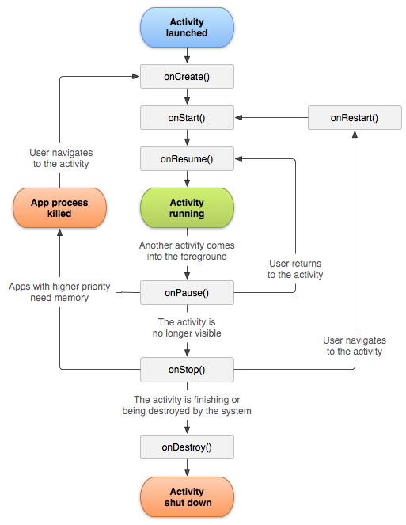
Activity Life Cycle

Slide 11
Activity Life Cycle
onCreate()
Gets fires when the system creates your activity.
To create views and bind data
In this function, a call to setContentView() is
placed, it determines the layout of user’s activity

Slide 12
Activity Life Cycle
onStart()
Gets called as onCreate() gets finished
This is where activity gets visible to user
Defines foreground and interactive nature

Slide 13
Activity Life Cycle
onResume()
Gets called just before the activity starts
interacting with the user

Slide 14
Activity Life Cycle
onPause()
Called when activity loses focus
Or enters paused state
Application may gets updated in background
Can’t be used to store data

Slide 15
Activity Life Cycle
onStop() – When activity is not visible to user
onDestroy() – Called before activity gets destroyed
onRestart() –
When activity is stopped and again started

Slide 16
Intent
An intent is an abstract description of an operation to be performed.
Android supports explicit and implicit Intents.
Explicit Intents
Explicit intents explicitly defines the component which should be called by the Android system, by using the Java class as identifier.
Implicit Intents
Implicit intents specify the action which should be performed and optionally data which provides data for the action.

Slide 17
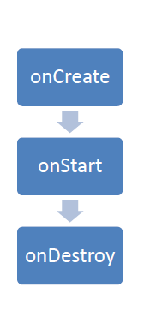
Service
A service is a component which runs in the background, without direct interaction with the user. The Android platform provides and runs predefined system services and every Android application can use them, given the right permissions.

Slide 18
Broadcast Receivers
Receive and react to broadcast announcements
Extend the class BroadcastReceiver
Examples of broadcasts:
Low battery, power connected, shutdown, timezone changed, etc.
Other applications can initiate broadcasts

Slide 19
Content Providers
Makes some of the application data available to other applications
It’s the only way to transfer data between applications in Android (no shared files, shared memory, pipes, etc.)
Extends the class ContentProvider;
Other applications use a ContentResolver object to access the data provided via a ContentProvider

Slide 20
Developing an First Android Application
Create a New Android Project in Android Studio ( What are selections that you need to do ?)
AndroidManifest.xml (What does it represent ?)
Activity_Main.xml (UI Components and Layouts )
Activity.java (Component Management and Event Handling)
How to create Emulator through AVD (Selection of parameters)
Execution of developed Android App

Slide 21
Android Activity State
Through overriding Lifecycle methods
Override this method to initialize your application singleton and create and initialize any application state variables or shared resources.
2. Through Lifecycle Owner and Observer
Lifecycle-owner components perform actions in response to a change in the lifecycle status of another component, such as activities and fragments. These components help you produce better-organized, and often lighter-weight code, that is easier to maintain.

Slide 22
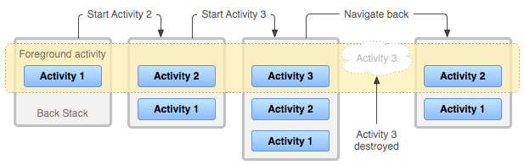
Android Activity Stack
Activities in the system are managed as activity stacks.
When a new activity is started, it is usually placed on the top of the current stack and becomes the running activity - the previous activity always remains below it in the stack, and will not come to the foreground again until the new activity exits.

Slide 23
Android Activity Stack
When the current activity starts another, the new activity is pushed on the top of the stack and takes focus.
Previous activity is present but in stopped state. [In Stop state, the system retains the current state of its user interface.]
When the user performs the back action, the current activity is popped from the top of the stack (the activity is destroyed) and the previous activity resumes (the previous state of its UI is restored).
Activities in the stack are never rearranged, only pushed and popped from the stack
Pushed when started and Popped when destroyed.
Back Stack follows Last In First Out Concept.

Slide 24
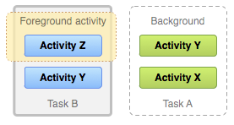
Android Activity Stack
Foreground and Background Tasks :
A task is a cohesive unit that can move to the background when a user begins a new task or goes to the Home screen.
In the background, all the activities in the task are stopped, but the back stack for the task remains intact—the task has simply lost focus while another task takes place.

Slide 25
Android Activity State
Active/Running State : In Foreground, Activity that user is currently interacting with
Visible : An activity has lost focus but is still presented to the user, new non-full-sized or transparent activity has focus on top of your activity
Stopped or Hidden : an activity is completely obscured by another activity, It still retains all state and member information, however, it is no longer visible to the user so its window is hidden and it will often be killed by the system when memory is needed elsewhere.
Destroyed : The system can drop the activity from memory by either asking it to finish, or simply killing its process

Slide 26
Android Intent
An Intent is a messaging object you can use to request an action from another app component.
Three major use case :
Start an Activity : An Activity represents a single screen in an app. You can start a new instance of an Activity by passing an Intent to startActivity().
Start a Service : A Service is a component that performs operations in the background without a user interface.
Deliver a Broadcast : A broadcast is a message that any app can receive. The system delivers various broadcasts for system events, such as when the system boots up or the device starts charging.

Slide 27
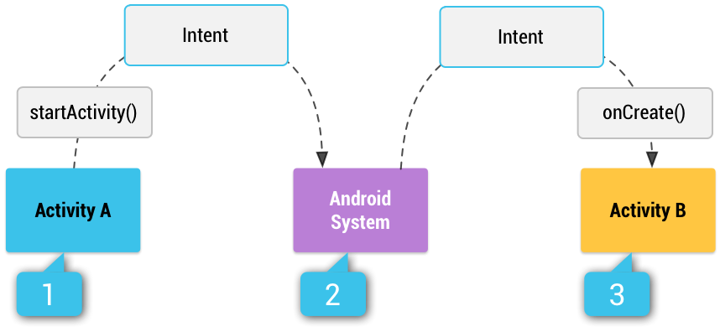
Android Intent Type
Explicit : specify which application will satisfy the intent, by supplying either the target app's package name or a fully-qualified component class name.
Implicit intents do not name a specific component, but instead declare a general action to perform, which allows a component from another app to handle it.

Slide 28
Android Intent Type
[1] Activity A creates an Intent with an action description and passes it to startActivity().
[2] The Android System searches all apps for an intent filter that matches the intent. When a match is found,
[3] the system starts the matching activity (Activity B) by invoking its onCreate() method and passing it the Intent.

Slide 29
Android Intent
Component Name : The name of the component to start
Action : Specifies which action to perform (ACTION_VIEW, ACTION_SEND)
Data : The URI (a Uri object) that references the data to be acted on and/or the MIME type of that data. (ACTION_EDIT) (setType() or setData() )
Category : A string containing additional information about the kind of component that should handle the intent. (CATEGORY_LAUNCHER or CATEGORY_BROWSEABLE)
Extras : Key-value pair
Flags : Flags are defined in the Intent class that function as metadata for the intent. The flags may instruct the Android system how to launch an activity and how to treat it after it's launched

